Slide 1
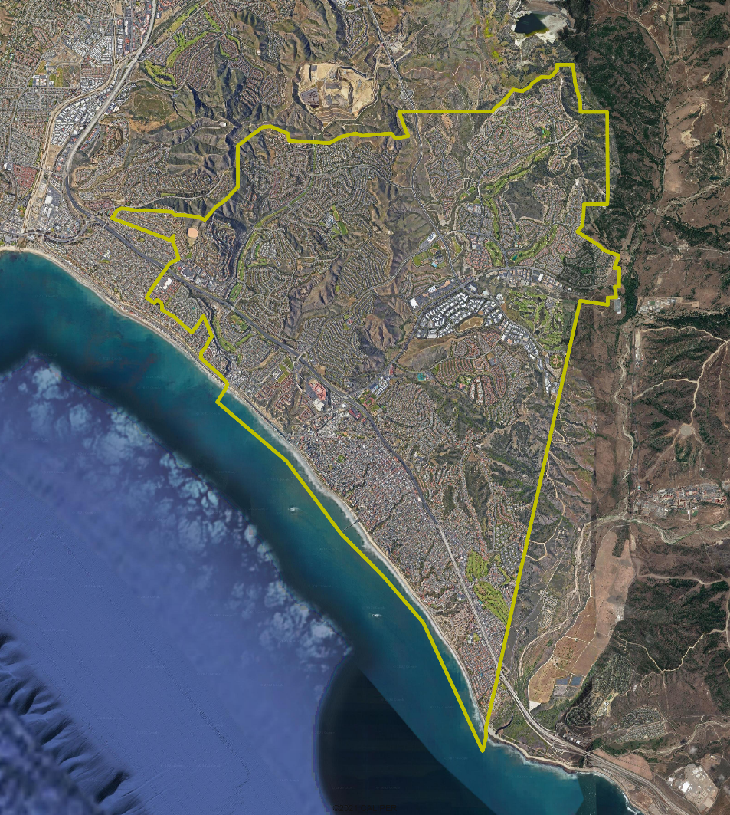
San Clemente Draft Plan Presentation

Slide 2
Districting Process
Step | Description
Two Initial Hearings | Held prior to release of draft maps. Education and to solicit input on the composition of districts.
Initial Public Map Submission Deadline | Public map submissions must be received this deadline to be considered by the Council at the 3rd hearing.
Release draft maps September 22, 2023 | Maps must be posted at least 7 days prior to 3rd hearing.
Initial draft map hearing October 3, 2023 | Meeting to discuss and revise the draft maps and to discuss the election sequence.
Final Public Map Submission Deadline October 6, 2023 | Public map submissions must be received by this deadline to be considered by the Council at the 4th hearing.
Release draft maps October 10, 2023 | Maps must be posted at least 7 days prior to 4th hearing.
Second draft map hearing October 17, 2023 | Meeting to discuss and revise the draft maps and to discuss the election sequence.
Map adoption | Map adopted via ordinance. Final map must be posted at least 7 days prior to adoption.

Slide 3
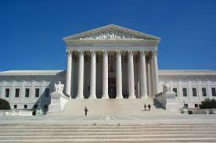
Districting Rules and Goals
1. Federal Laws
2. California Criteria for Cities
3. Other Traditional Redistricting Principles
Equal Population
Federal Voting Rights Act
No Racial Gerrymandering
Geographically contiguous
Undivided neighborhoods and “communities of interest” (Socio-economic geographic areas that should be kept together)
Easily identifiable boundaries
Compact (Do not bypass one group of people to get to a more distant group of people)
Prohibited: “Shall not favor or discriminate against a political party.”
Respect voters’ choices / continuity in office
Future population growth

Slide 4
Four-District Draft Maps
All maps are also available on the Interactive Web Viewer

Slide 5
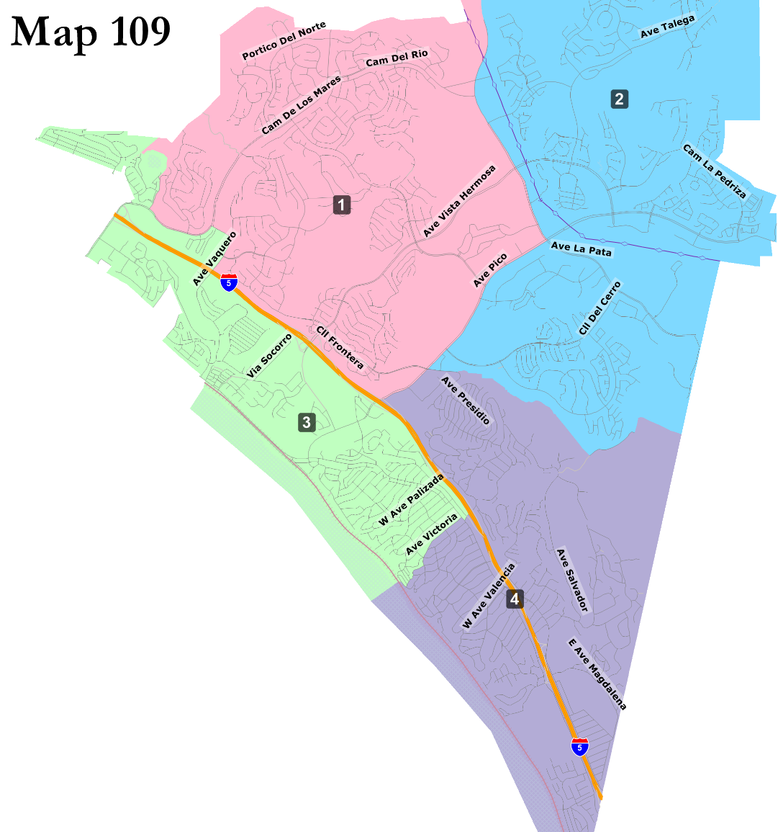
Maps with northern coastal district
Interactive Web Viewer

Slide 6
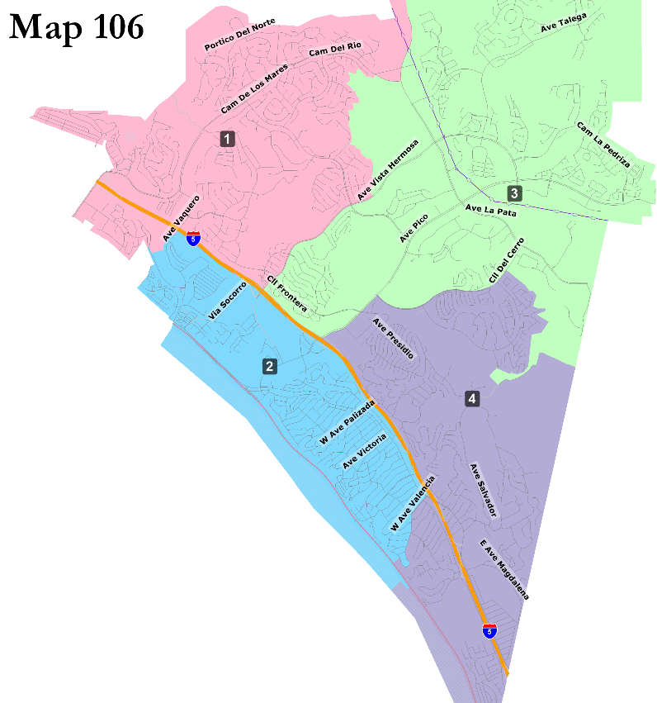
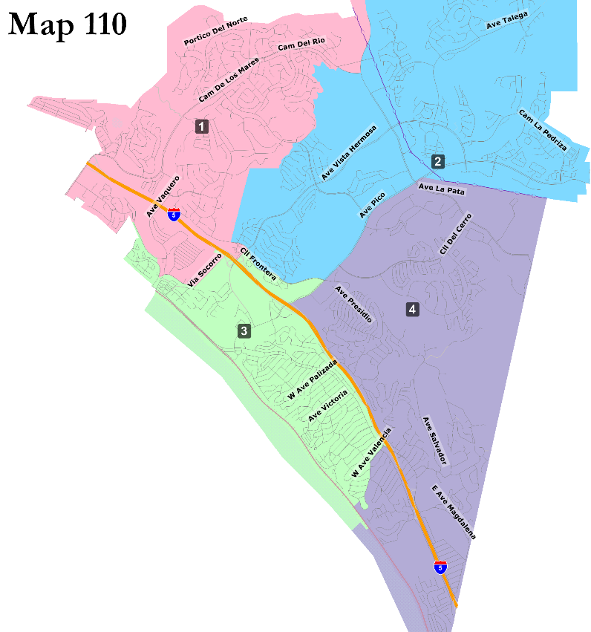
Maps with Talega connected to I-5
Interactive Web Viewer

Slide 7
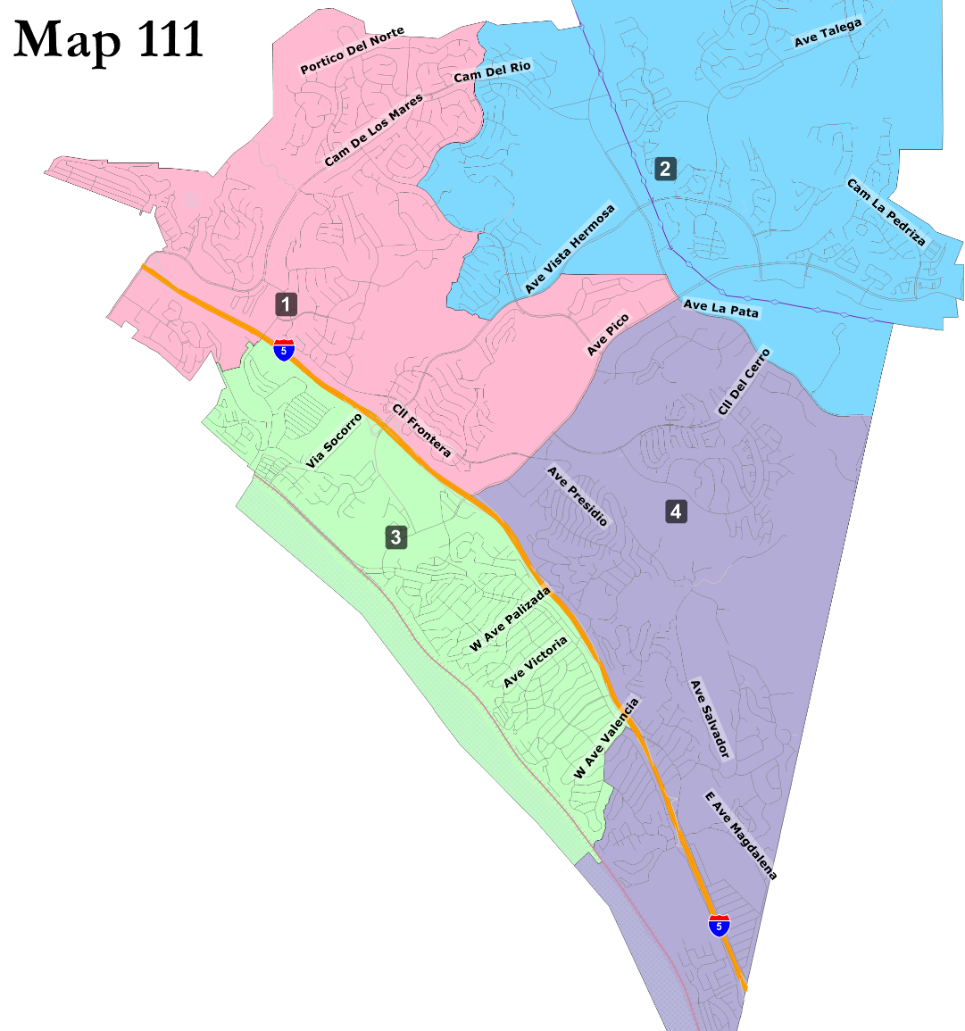
Maps using Avenida Pico
Interactive Web Viewer

Slide 8
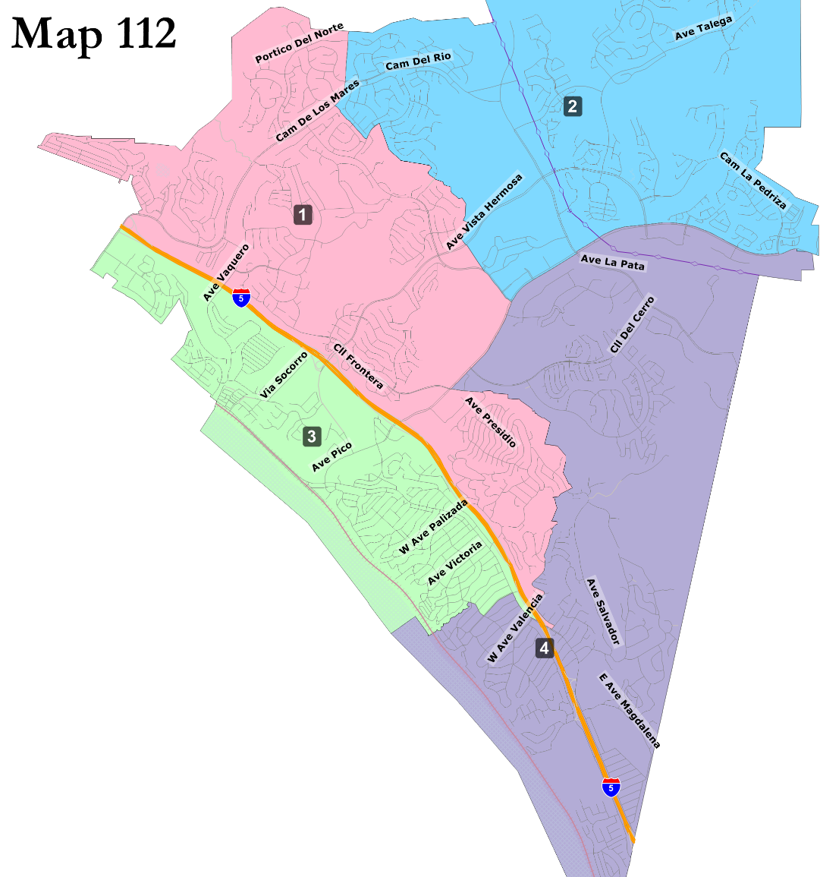
Unique Four-district Maps
Interactive Web Viewer

Slide 9
Five-District Draft Maps
All maps are also available on the Interactive Web Viewer

Slide 10
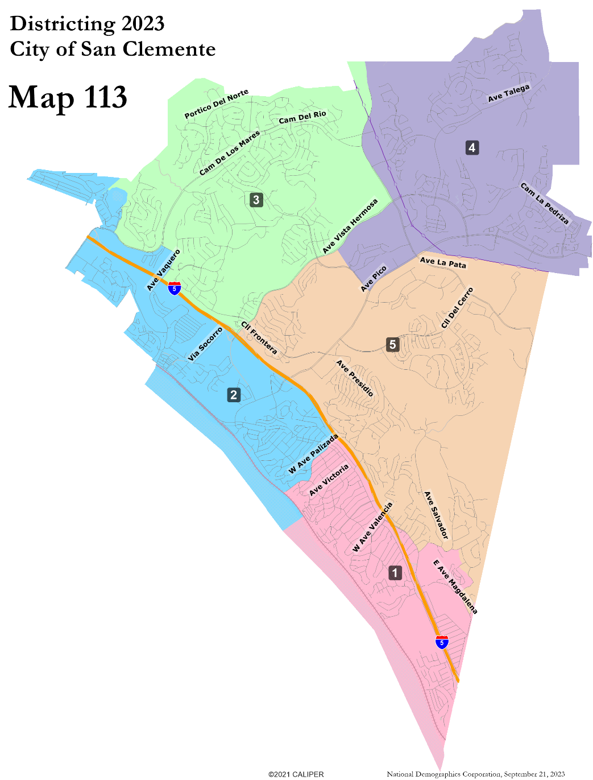
Compact northern districts
Interactive Web Viewer

Slide 11
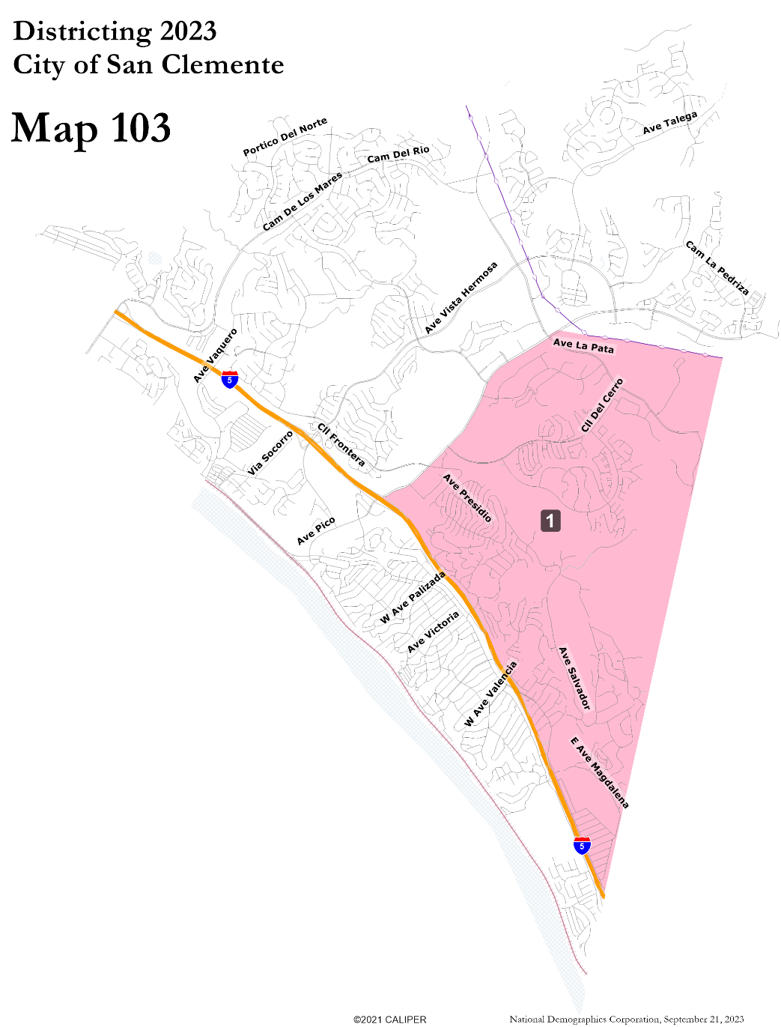
Other Five-District Maps
Interactive Web Viewer

Slide 12
Summary of Maps
Map Number | Dist. (4 or 5) | HOAs divided | Notes
101 | 4 | 0
102 | 4 | 1 (Forster Highlands) | Received from 12 individuals
103 | 5* | 0* | Single district map
104 | 4 | 1 (The Reserve)
105 | 4 | 1 (Forster Highlands)
106 | 4 | 0
107 | 5 | 1 (Forster Highlands)
108 | 5 | 0
109 | 4 | 0
110 | 4 | 0
111 | 4 | 0
112 | 4 | 0
113 | 5 | 0

Slide 13
Sequence of Elections
The final map will need to have a sequence of elections indicating which districts will hold their first elections in 2024 and 2026
The Council can designate any sequence they choose.
However, the Council cannot change the number of seats holding election
This means:
Two seats must be placed up for election in 2024
Three seats must be placed up for election in 2026
Current Council terms are not affected
Councilmembers may serve out the full term they were elected;
Councilmembers are only considered to be “by-district” after being elected from a district.
Vacancies are filled in the manner of the last election for that seat

Slide 14
Discussion
What do you like or dislike about the draft maps?
Which map will serve San Clemente best?
Next steps:
Selection of three to four “focus maps” and any requests for tests or revisions (if desired)
Additional map submissions due October 6, 2023
New/revised maps posted October 10, 2023

