Slide 1
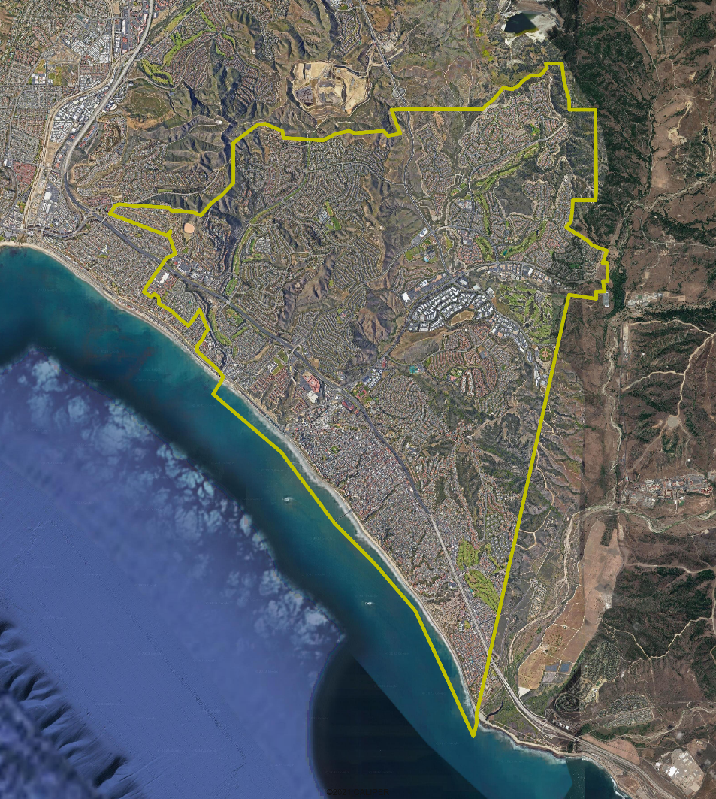
San Clemente Introduction to Districting

Slide 2
Election Systems
“At Large”
“From District” or “Residence” Districts
“By District”
The California Voting Rights Act was written to specifically encourage by-district elections.

Slide 3
California Voting Rights Act (CVRA)
Under the Federal Voting Rights Act (passed in 1965), a jurisdiction must fail 4 factual tests before it is in violation of the law.
The California VRA makes it significantly easier for plaintiffs to force jurisdictions into “by-district” election systems by eliminating two of the US Supreme Court Gingles tests:
Can the protected class constitute the majority of a district?
Does the protected class vote as a bloc?
Do the voters who are not in the protected class vote in a bloc to defeat the preferred candidates of the protected class?
Do the “totality of circumstances” indicate race is a factor in elections?
Liability is now determined only by the presence of racially polarized voting

Slide 4
CVRA Impact
Switched (or in the process of switching) as a result of CVRA:
At least 275 school districts
36 Community College Districts
191 cities
1 County Board of Supervisors
53 water and other special districts.
Cases So Far:
Palmdale, Santa Clara and Santa Monica went to trial on the merits. Palmdale and Santa Clara lost. Santa Monica is awaiting a decision.
Modesto and Palmdale each spent about $1.8 million on their defense (in addition to the attorney fee awards in those cases).
Santa Monica has spent an estimated $7 million so far. Plaintiffs in Santa Monica requested $22 million in legal fees after the original trial.
Key settlements:
Palmdale: $4.7 million
Modesto: $3 million
Highland: $1.3 million
Anaheim: $1.1 million
Whittier: $1 million
Santa Barbara: $600,000
Tulare Hospital: $500,000
Camarillo: $233,000
Compton Unified: $200,000
Madera Unified: about $170,000
Hanford Joint Union Schools: $118,000
Merced City: $42,000
An estimated $16 million in total settlements and court awards so far.

Slide 5
CVRA Impact in Orange County
Council Elections in 2010
Council Elections today

Slide 6
Districting Process
Step | Description
Two Initial Hearings | Held prior to release of draft maps. Education and to solicit input on the composition of districts.
Initial Public Map Submission Deadline | Public map submissions must be received this deadline to be considered by the Council at the 3rd hearing.
Release draft maps | Maps must be posted at least 7 days prior to 3rd hearing.
Initial draft map hearing | Two meetings to discuss and revise the draft maps and to discuss the election sequence.
Final Public Map Submission Deadline | Public map submissions must be received by this deadline to be considered by the Council at the 4th hearing.
Release draft maps | Maps must be posted at least 7 days prior to 4th hearing.
Second draft map hearing | Two meetings to discuss and revise the draft maps and to discuss the election sequence.
Map adoption | Map adopted via ordinance. Final map must be posted at least 7 days prior to adoption.

Slide 7
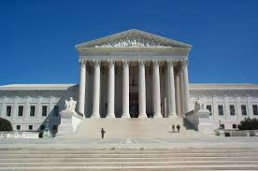
Districting Rules and Goals
1. Federal Laws
2. California Criteria for Cities
3. Other Traditional Redistricting Principles
Equal Population
Federal Voting Rights Act
No Racial Gerrymandering
Geographically contiguous
Undivided neighborhoods and “communities of interest” (Socio-economic geographic areas that should be kept together)
Easily identifiable boundaries
Compact (Do not bypass one group of people to get to a more distant group of people)
Prohibited: “Shall not favor or discriminate against a political party.”
Respect voters’ choices / continuity in office
Future population growth

Slide 8
Demographic Summary
Each of four districts must contain about 16,100 people.
Each of five districts must contain about 12,900 people.

Slide 9
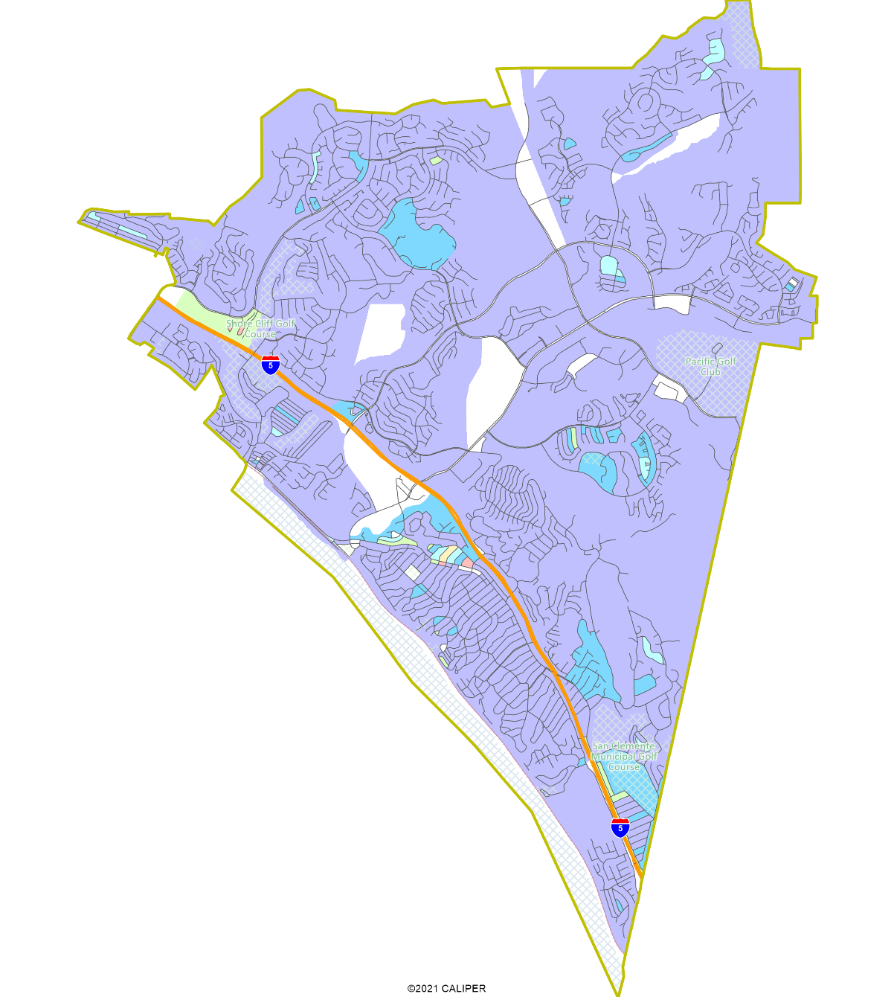
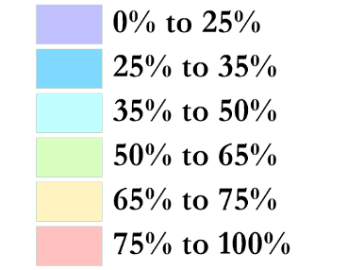
Latino CVAP
There is a geographic concentration of Latinos in and around the Vista Los Mares apartments (next to Ocean View Plaza).

Slide 10
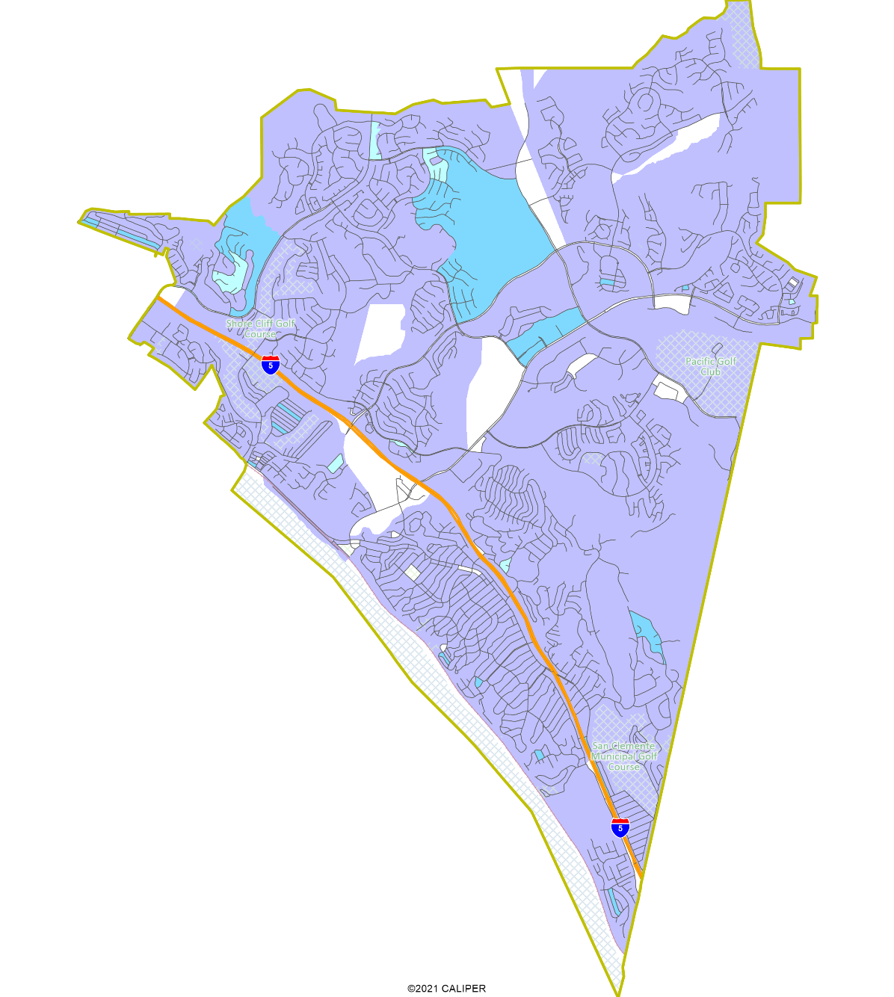
Asian-American CVAP
Asian-Americans are slightly concentrated in the north of the city along Camino de los Mares and Camino del Rio.

Slide 11
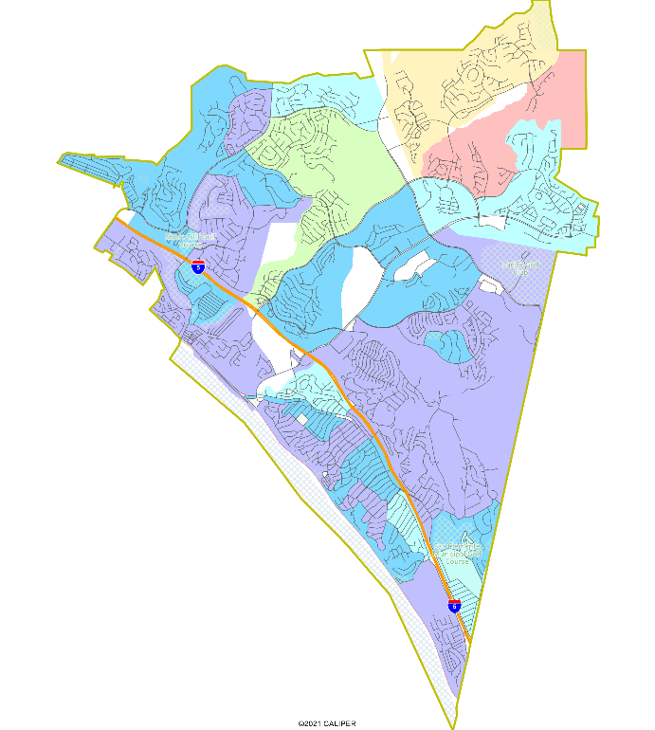
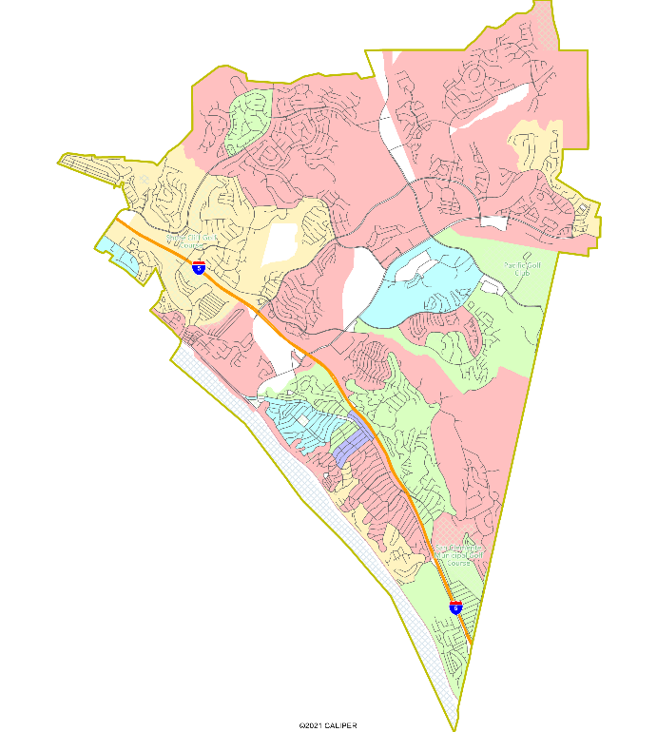
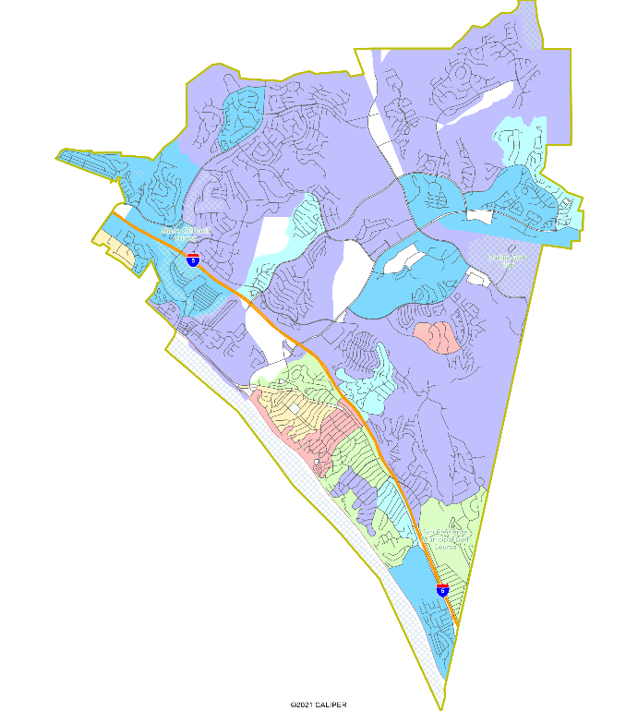
Other Socio-Economic Demographics
Children under 18 at home
Household income over $75,000 per year
Renters

Slide 12
Defining Neighborhoods
1st Question: What is your neighborhood?
2nd Question: What are its geographic boundaries?
Examples of physical features defining a neighborhood boundary:
Natural neighborhood dividing lines, such as highway or major roads, rivers, canals and/or hills
Areas around parks or schools
Other neighborhood landmarks
In the absence of public testimony, planning records and other similar documents may provide definition.

Slide 13
Beyond Neighborhoods: Defining Communities of Interest
1st Question: What defines your community?
Geographic Area, plus
Shared issue or characteristic
Shared social or economic interest
Impacted by county policies
Tell us “your community’s story”
2nd Question: Would this community benefit from being “included within a single district for purposes of its effective and fair representation”?
Or would it benefit more from having multiple representatives?
Definitions of Communities of Interest may not include relationships with political parties, incumbents, or political candidates.

Slide 14
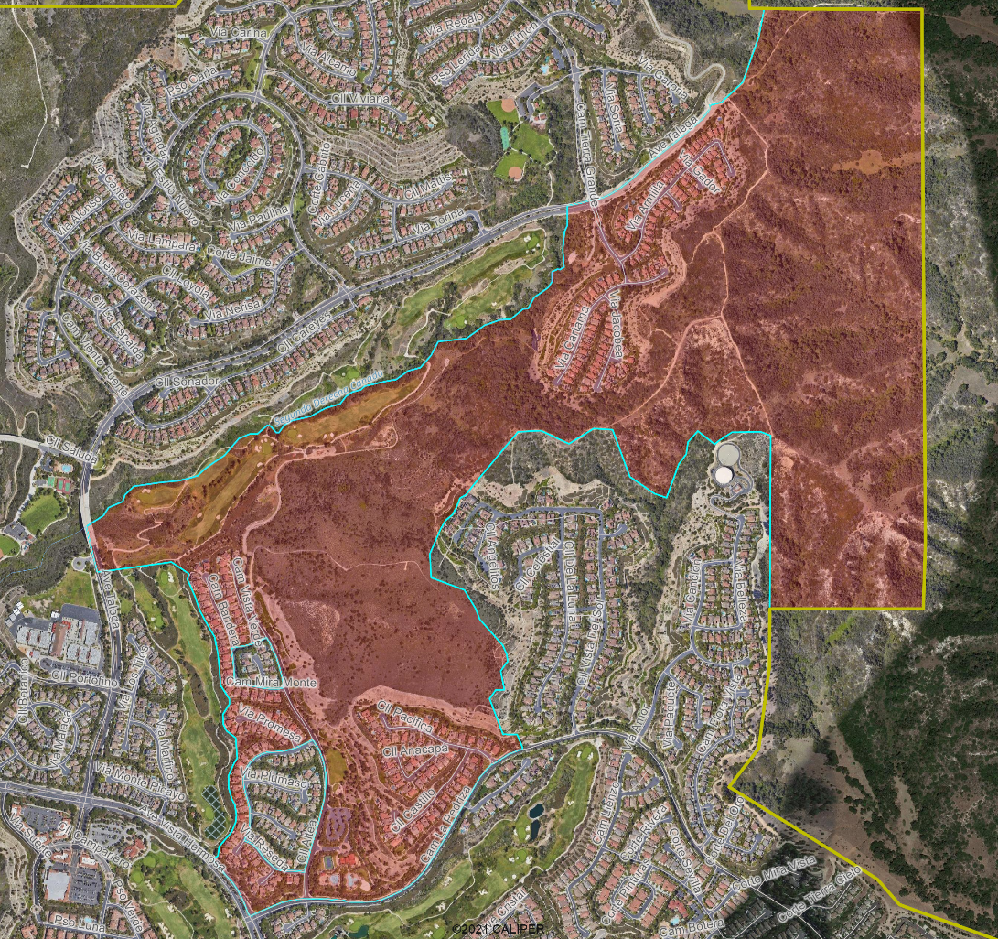
Census Block Problems
Census Block lines (shown in blue) do not turn out well where there are hillsides, cul-de-sacs or other neighborhoods not clearly bounded by streets.
NDC will carefully divide the Census Blocks and assigned their population shares to the underlying neighborhoods.
The base layer of geography for maps will be based on local neighborhood boundaries within Census Blocks.

Slide 15
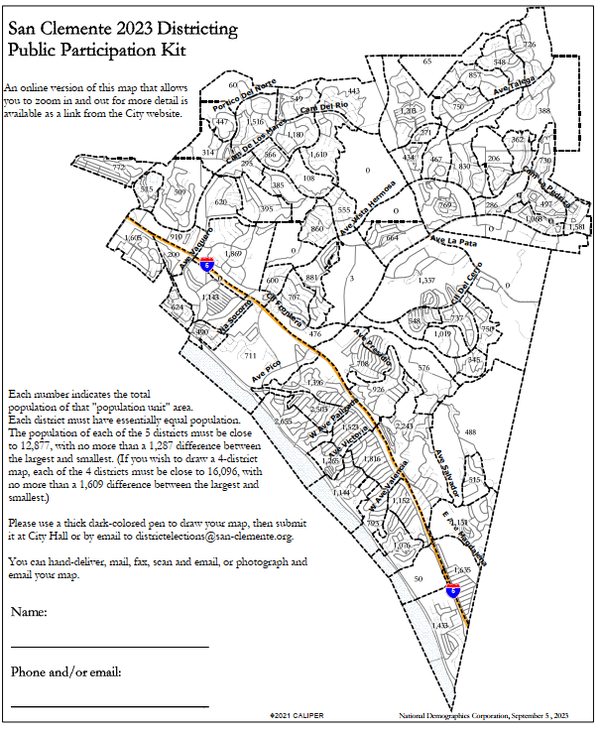
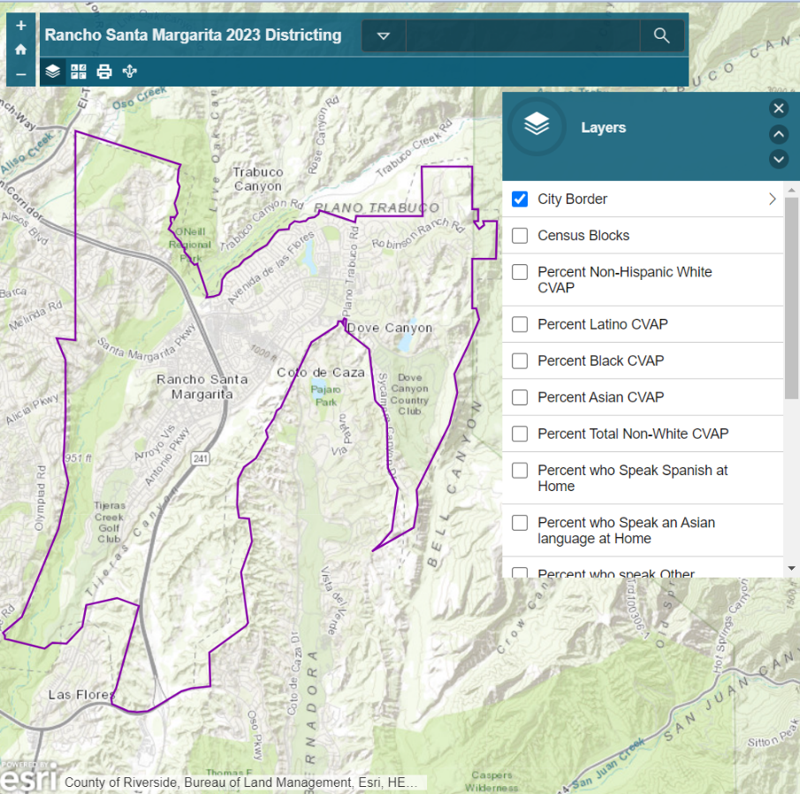
Public Mapping and Map Review Tools
Different tools for different purposes
Different tools for different levels of technical skill and interest
Simple “review draft maps” tool
Paper-based “Draw a draft map” tool
Sample – San Clemente Version Coming Soon!

Slide 16
Public Hearing & Discussion
What is your neighborhood and what are its boundaries?
What other notable areas are in the City, and what are their boundaries?
Any questions about the map tools?

