Slide 1

Public Workshop
Water Cost of Service & Rate Study
August 10, 2016

Slide 2
Public Workshop #1: Today’s workshop is designed to be both educational and to seek broad input from the community
Project Overview
Introduction to Cost of Service
Public Comment Q&A

Slide 3
Purpose – Adjusting to the New Normal: Changes to water demands and system costs necessitate review of existing rates and charges
Identified Challenges
Water Use is down
Revenue Resiliency
How it is remedied?
Other Considerations
Implementation of January 1, 2017
Identify revenue needs
Analyze customer data
Align expenditures with use and revenues
Expenditures exceed revenues
Customer Understanding & Acceptance
Customer impacts

Slide 4
System Overview: San Clemente Water System by the numbers…
210 miles of water lines
14 reservoirs
16 pump stations
2 groundwater wells
3 sources of supply
56 pressure reducing stations
Over 17,500 customers

Slide 5
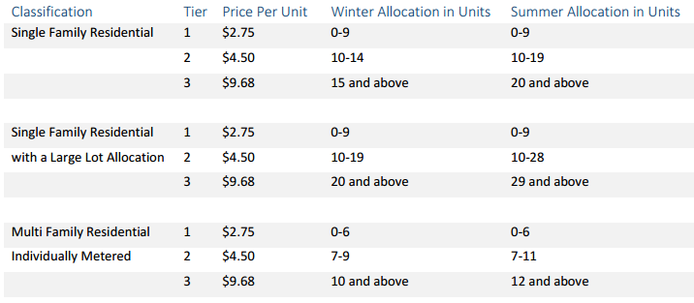
Existing Rates: Will be reviewed for potential adjustments
Have the assumptions and objectives behind this rate structure changed?
Should they be updated/refined?
What are potential customer Impacts?
What is the potential revenue (financial) risk?

Slide 6
Introduction to
Cost of Service

Slide 7
Cost of Service Analysis: Step-by-Step approach to developing sound and defensible rates
Revenue Requirement Analysis
Cost of Service Analysis
Rate-Design Analysis
Policy & Rate Structure Review
Public Outreach & Messaging
Demand Analysis

Slide 8
Policy and Rate Objectives: High-level direction based on specific City needs and community values
Study Objectives
Financial Stability
Policy Considerations
Financial Resilience
Legal Compliance
Cost of Service Pricing
Cost Recovery
Administrative Ease
Customer Impacts & Acceptance
Community Values

Slide 9
Cost of Service Analysis: Step-by-Step Approach
Revenue Requirement Analysis
Cost of Service Analysis
Rate-Design Analysis
Policy & Rate Structure Review
Public Outreach & Messaging
Demand Analysis

Slide 10
Revenue Requirement: Forecasts expenditures and defines necessary revenue levels
Revenues vs Expenditures
Aims to bridge potential shortfalls through rate changes
Must also account for:
  Interplay of demands and expenses
  Impacts to cash flow
  Funding, capital, and other policy goals
  Customer price elasticity
  Risk and uncertainty of multiple factors

Slide 11
Cost of Service Analysis: Step-by-Step Approach
Revenue Requirement Analysis
Cost of Service Analysis
Rate-Design Analysis
Policy & Rate Structure Review
Public Outreach & Messaging
Demand Analysis

Slide 12
What is the New Normal: Forecasting future demands will significantly impact revenues and expenditures?
Demand last year
fell 26%
from the 10-year average, and was
14% lower than the previous low set in 2010-11

Slide 13
Cost of Service Analysis: Step-by-Step Approach
Revenue Requirement Analysis
Cost of Service Analysis
Rate-Design Analysis
Policy & Rate Structure Review
Public Outreach & Messaging
Demand Analysis

Slide 14

Cost of Service Analysis: Defines how costs are incurred and how revenues should be recovered
Water System
System Functions
Revenue Categories
Water Resources
Storage
Customer
Conveyance
Meter Size
Distribution
Usage
Billing & Admin

Slide 15
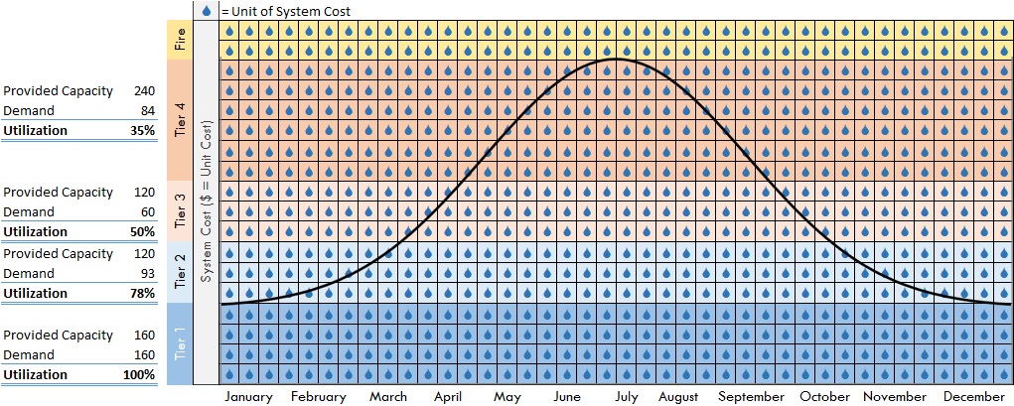
Question: How can tiered rates be easily defined?
Tiered rates capture the increasing costs incurred to meet peak demands

Slide 16
Cost of Service Analysis: Step-by-Step Approach
Revenue Requirement Analysis
Cost of Service Analysis
Rate-Design Analysis
Policy & Rate Structure Review
Public Outreach & Messaging
Demand Analysis

Slide 17
Rate Design Analysis: Rate considerations will balance your needs
Rate Design
Financial Stability
Economic Uncertainty
Reliable Projections
Sufficient Revenue
Prop. 218 Compliance
Equity Across Customer Classes
Affordability at low usage
Have the assumptions and objectives behind this rate structure changed?
Should they be updated/refined?
What are potential customer Impacts?
What is the potential revenue (financial) risk?

Slide 18
Rate Alternatives: Review to encompass a variety of available alternatives to achieve key objectives
“What are the available alternatives”
“Can Rate Design be meet key objectives?”
Encourage Conservation
Financial Stability
Administrative Ease
Fairness
Equity Across Customer Classes
Affordability at low usage

Slide 19
Cost of Service Analysis: Step-by-Step Approach
Revenue Requirement Analysis
Cost of Service Analysis
Rate-Design Analysis
Policy & Rate Structure Review
Public Outreach & Messaging
Demand Analysis

Slide 20
Schedule and Next Steps
Rate Adoption
Introduction of Draft Results
Council Meeting (October)
Consideration of Initiating Proposition 218 Process
Council Meeting (November)
January 1, 2017
Preparation of Draft Results
August - October

Slide 21

Additional Questions:
Tom Rendina – City of San Clemente
Phone:(949) 361-8312
Email: RendinaT@san-clemente.org
Q&A

Slide 22
Defining the New Normal: Consumption will be analyzed to determine the impact of conservation on existing breakpoints
Prior to drought - relatively consistency
Drought has impacted behaviors

Slide 23
Tiered Rates: Tiers will also be built directly upon key system attributes
Primarily funded by tier
Partially funded by tier
Not funded by tier
Tier 1
Tier 2
Tier 3
Local Groundwater
Imported Water
Future Supplies
Conservation

Slide 24
Thank You

Slide 25
Revenue Risk: We will forecast City’s cash flow under various demand scenarios
Shortfall shows need for additional revenue under drought stages

Slide 26
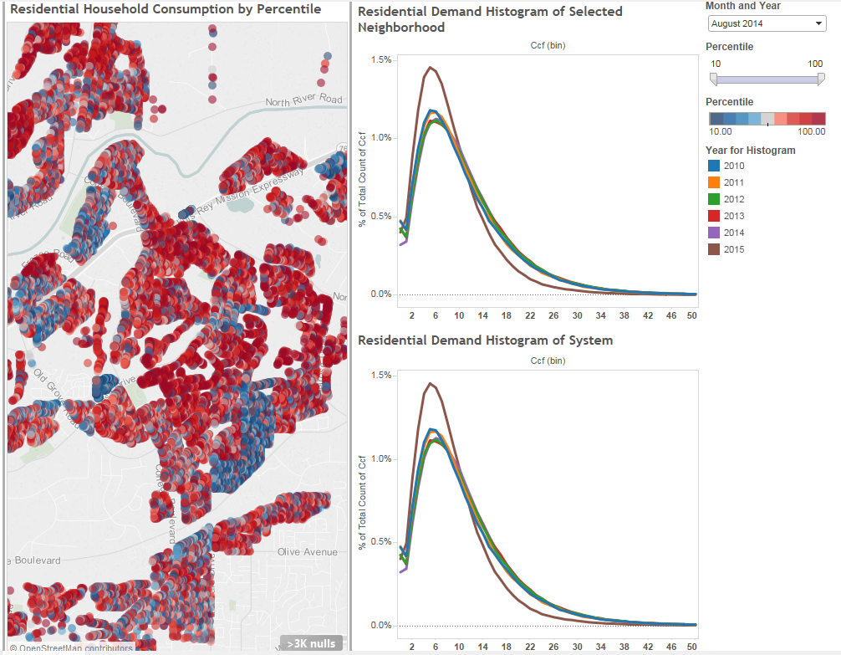
Advanced Data Analysis: Establishes a comprehensive understanding of your customer demands and characteristics
Quick visualizations
offer better clarity
Scenario modeling simplifies decision making
Max month demand in relation to Average month demand
Max month demand in relation to Min month demand
Analysis provides basis why rates vary by customer class

Slide 27
Demand Bounce Back: We will analyze where conservation has occurred and estimate the impact of demand hardening

Slide 28
Rate Layering: Rates can be broken down into multiple components in compliance with Proposition 218
Rate Component ($/CCF) | Tier 1 | Tier 2 | Tier 3 | Tier 4
Supplies
Distribution | $0.58 | $0.58 | $0.58 | $0.58
Local Groundwater | $1.01
Desalter & Imported Water |  | $3.13 | $3.13 | $3.13
Surcharges
Tier 3 Peak Components |  |  | $1.31
Tier 4 Peak Components |  |  |  | $7.69
Additional Conservation Needs |  |  | $0.44 | $0.44
Recycled Water Avoided Costs |  |  | $0.22 | $0.22
Proposed Rates ($/CCF) | $1.59 | $3.71 | $5.67 | $12.05

Slide 29
Agencies throughout the State are facing similar challenges…
Primarily, revenue stability, cost recovery, and capital funding
Increasing Fixed Charges…
Yorba Linda: 18% to 45%
Upland: 14% to 30%
Including Surcharges…
EMWD: 20% to 30-35%
Rate Increases…
City of San Diego: 9.8%, 6.9%, 6.9%, 5%, 7%
City of Vallejo: 35%, 35%, 8%, 8%, 8%
Vallejo: 33% to 85% (5yr phase)
MNWD: 7%, 7%, 5%, 4% for 7 yrs
Arcadia: 15%, 15%, 7%, 7%, 7%
Arcadia: 15% to 25% (5 yr phase)
Yorba Linda: 36%, 5% for 4 yrs
MNWD: Stage 2 and beyond, customers face tier 5 rate of $9.04 for usage in excess of budget
MVWD: Demand Based commodity rates. Noticed 5 separate rate schedules based on various demand/water supply forecasts
The drought and aging infrastructure have revealed fallacies and challenges of variable rate revenues

Slide 30
Question: How can tiered rates be easily defined?
Tiered rates capture the increasing costs incurred to meet peak demands
Tier 4 Demand
System Capacity
Cost per Unit Water
Tier 3 Demand
Tier 2 Demand
Tier 1 Demand
January
December

